Slide 1



Optimal Manpower Planning with Regular and Contingent Employees in Software Industry
Team Name: Neo | Group 2 | EBAC 5
Aastha Arora (A0178188L) Anusuya Manickavasagam (A0163300Y) Chetna Gupta (A0178260A) Kesavan Sridhar (A0163207M) Muni Ranjan (A0163382E) Pradeep Kumar (A0163453H) Zaira Hossain (A0178331E)

Slide 2

Business Statement

Slide 3
Detailed Approach
Minimize
COST: S1*X1 + S2*Y1 + S3*A1 + S4*B1 + S3*A2 + S4*B2 + S3*A3 + S4*B3 + S3*A4 + S4*B4
Subject To:
24 X1+ 24 A1 + 48 Y1 + 48 B1 >= q1+d1
24 X1+ 24 A2 + 48 Y1 + 48 B2 >= q2-d1+d2
24 X1+ 24 A3 + 48 Y1 + 48 B3 >= q3-d2+d3
24 X1+ 24 A4 + 48 Y1 + 48 B4 >= q4-d3
(A1 + B1)/(A1 + B1 + X1 + Y1) >=P1
(A2 + B2/(A2+ B2 + X1 + Y1) >= P2
(A3 + B3/(A3+ B3 + X1 + Y1) >= P3
(A4 + B4/(A4+ B4 + X1 + Y1) >= P4
Bounds:
X1, Y1, A1, B1, A2, B2, A3, B3, A4, B4 >= 1
-100 <= D1 <= 100
-100 <= D2 <= 100
-100 <= D3 <= 100
Where:
X1 = Number of Regular Software Engineers (SE)
S1 = Annual Salary of Regular Software Engineers
Y1 = Number of Regular of Senior Software Engineers (SSE)
S2 = Annual Salary of Regular Senior Software Engineers
Ai = Number of Contingent Software Engineers in quarter i (i = 1 to 4)

Slide 4
Equation
S3 = Quarterly Salary of Contingent Software Engineers
Bi = Number of Contingent Senior Software Engineers in quarter i (i = 1 to 4)
S4 = Quarterly Salary of Contingent Software Engineers
Pi = Proportion of contingent employee to total in quarter i (i=1 to 4)
Di = Delta in work for quarter i (i=1 to 3)

Slide 5
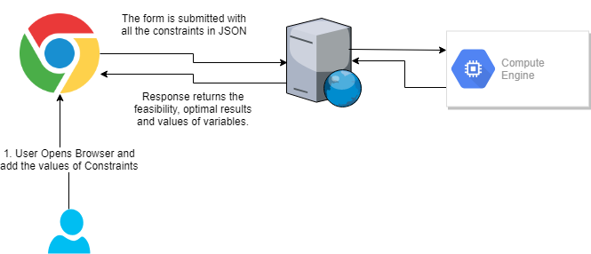
App Solution Diagram

Slide 6
Live App Demo

Slide 7
THANKS!
Q/A

